Slide 1
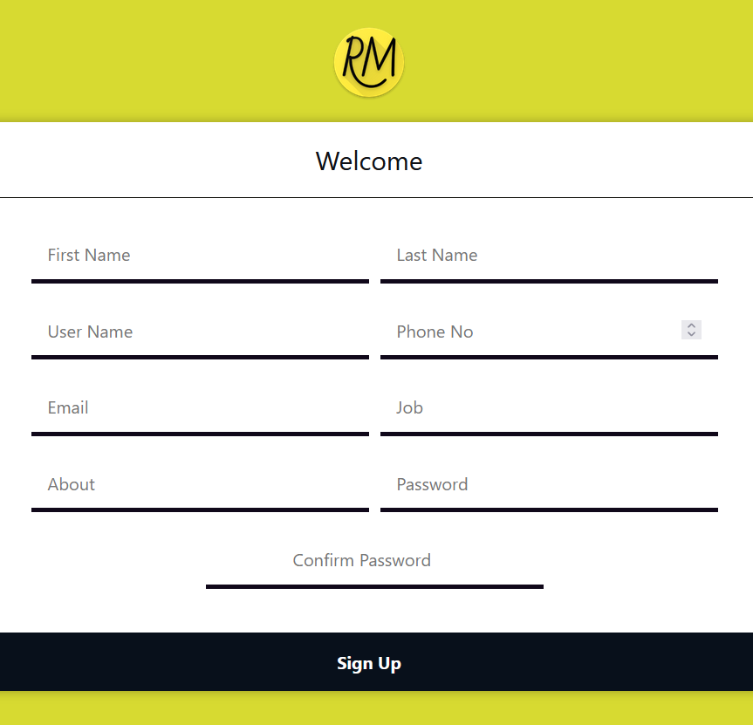
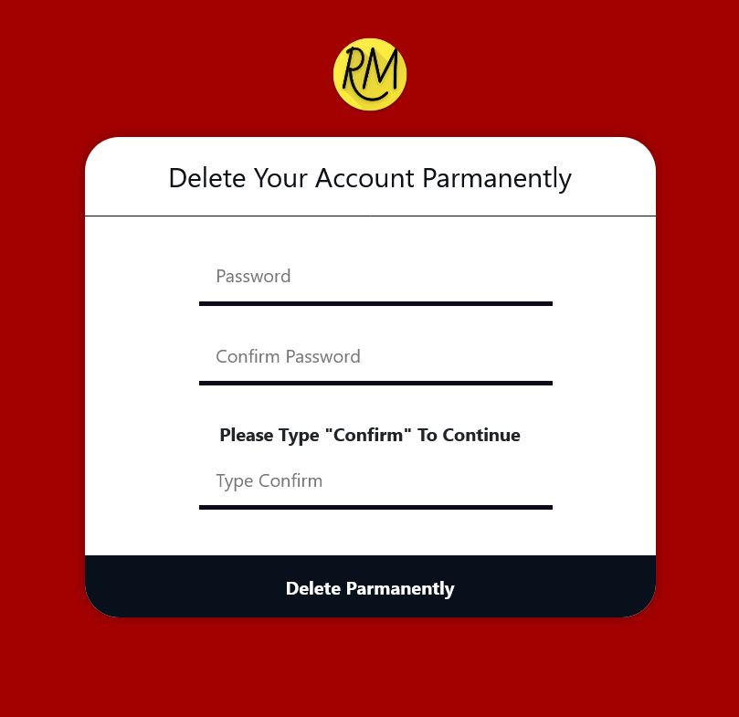
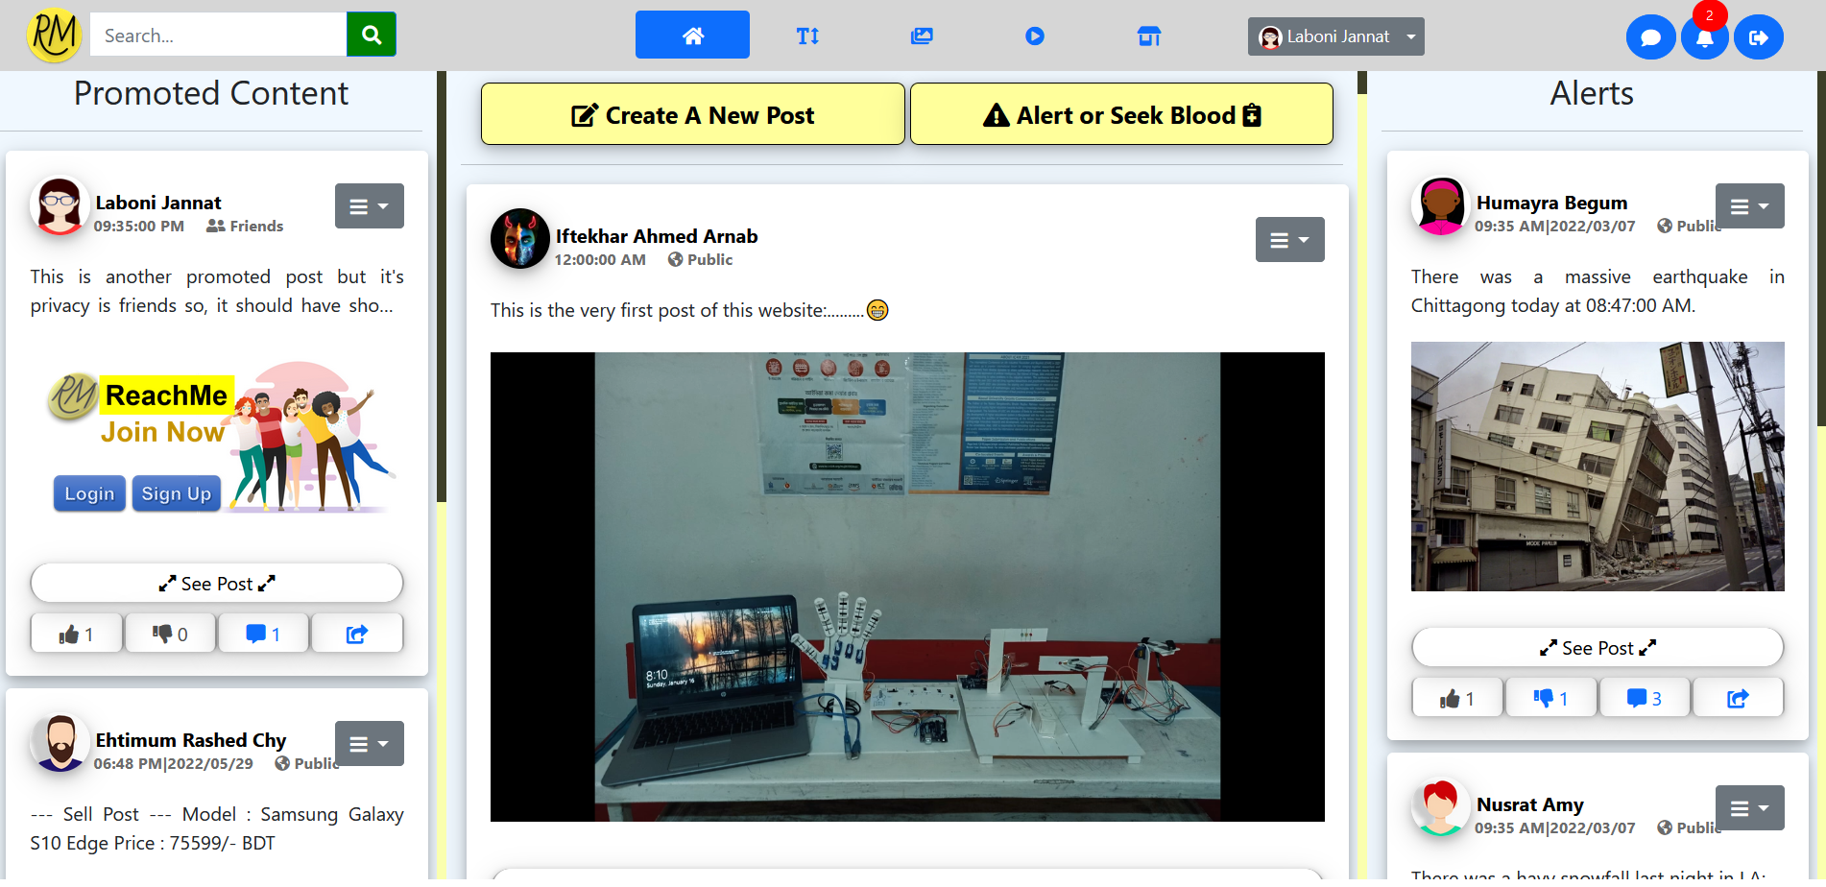
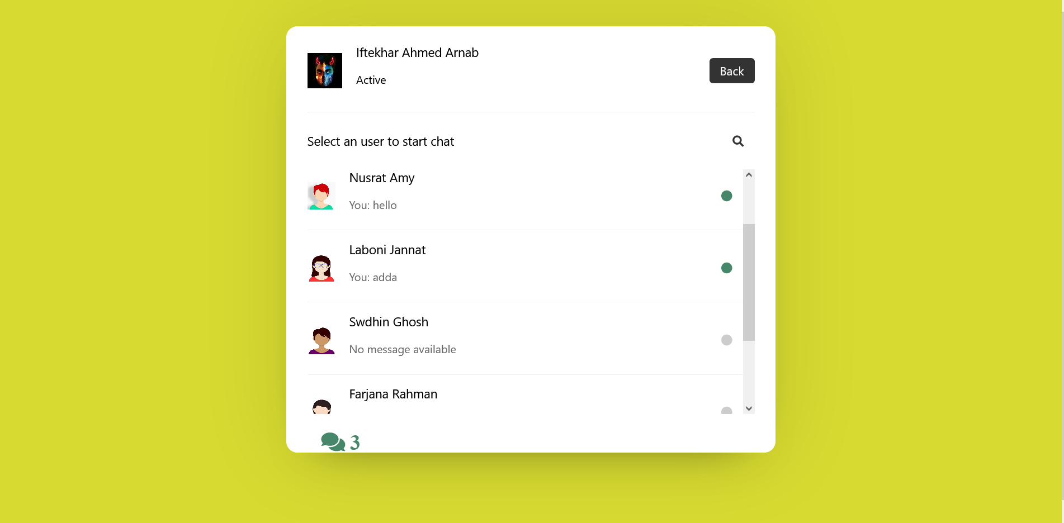
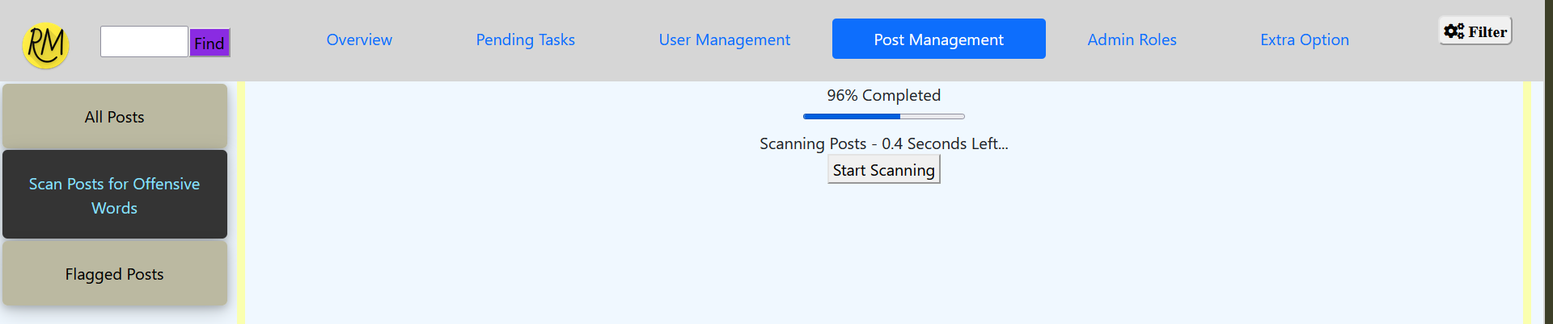
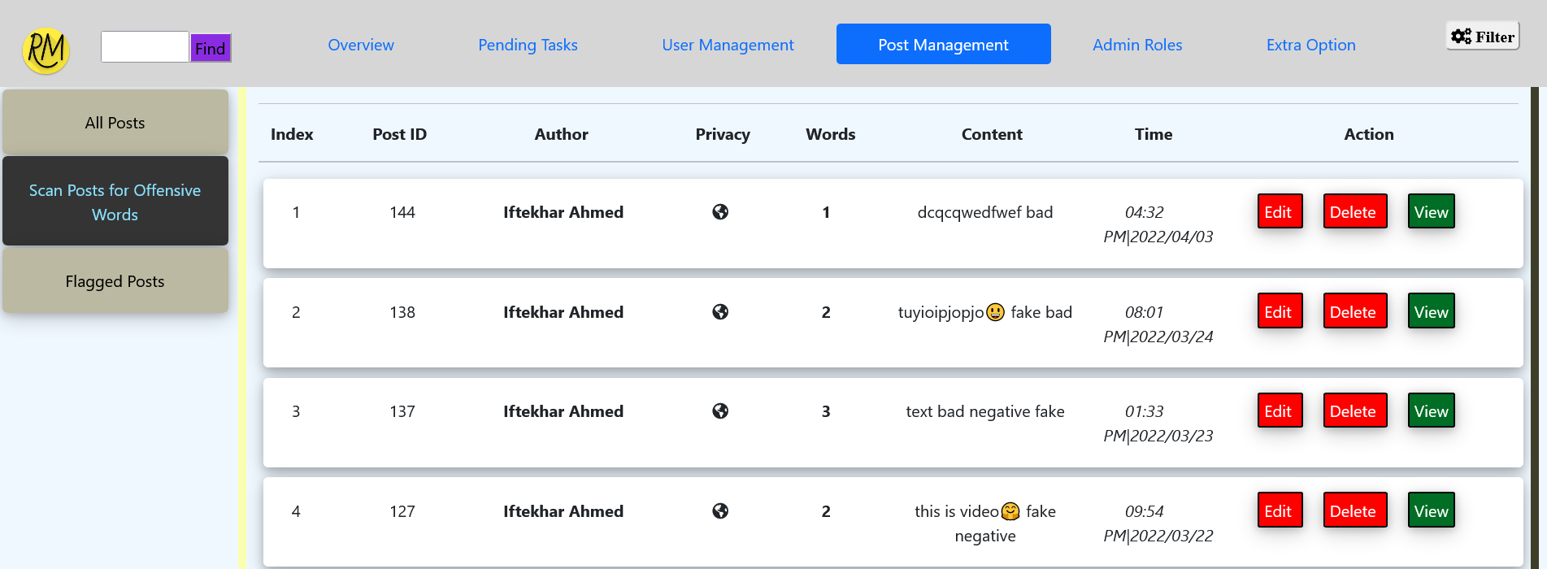
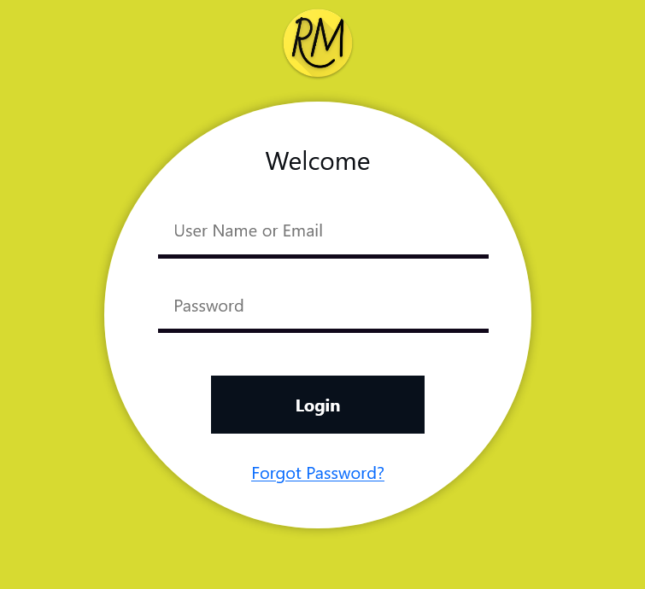
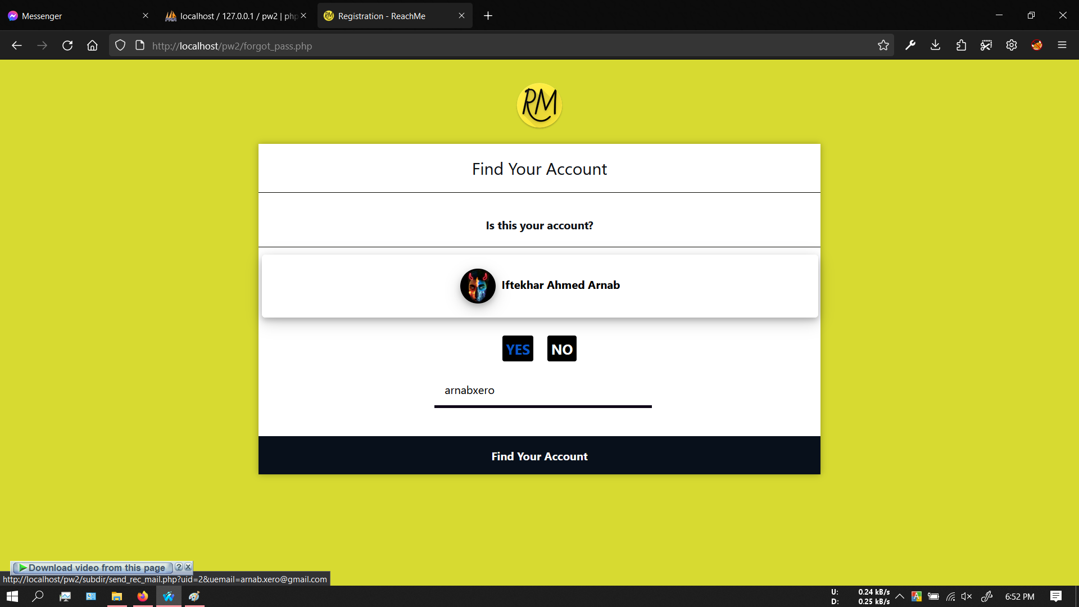
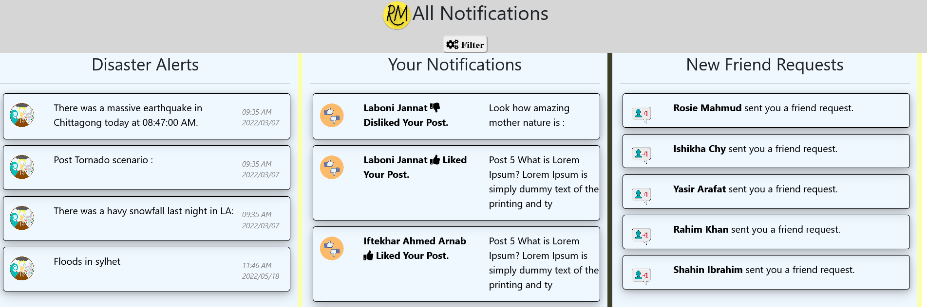
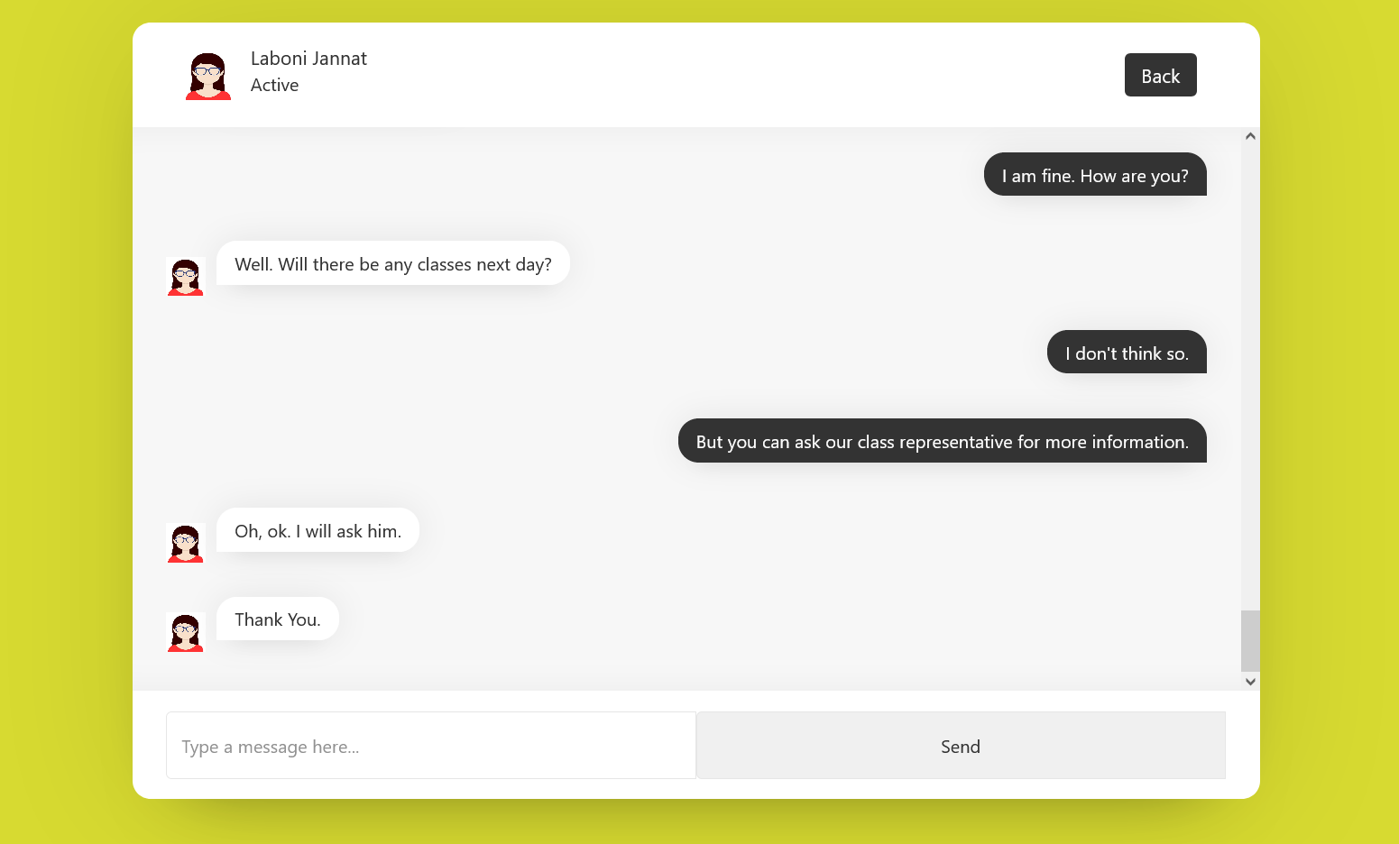
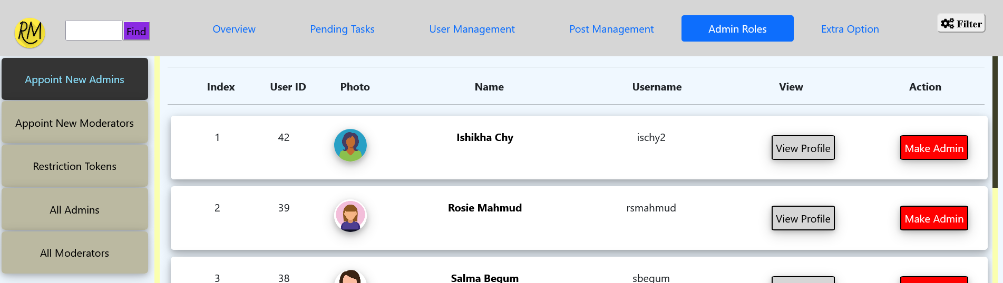
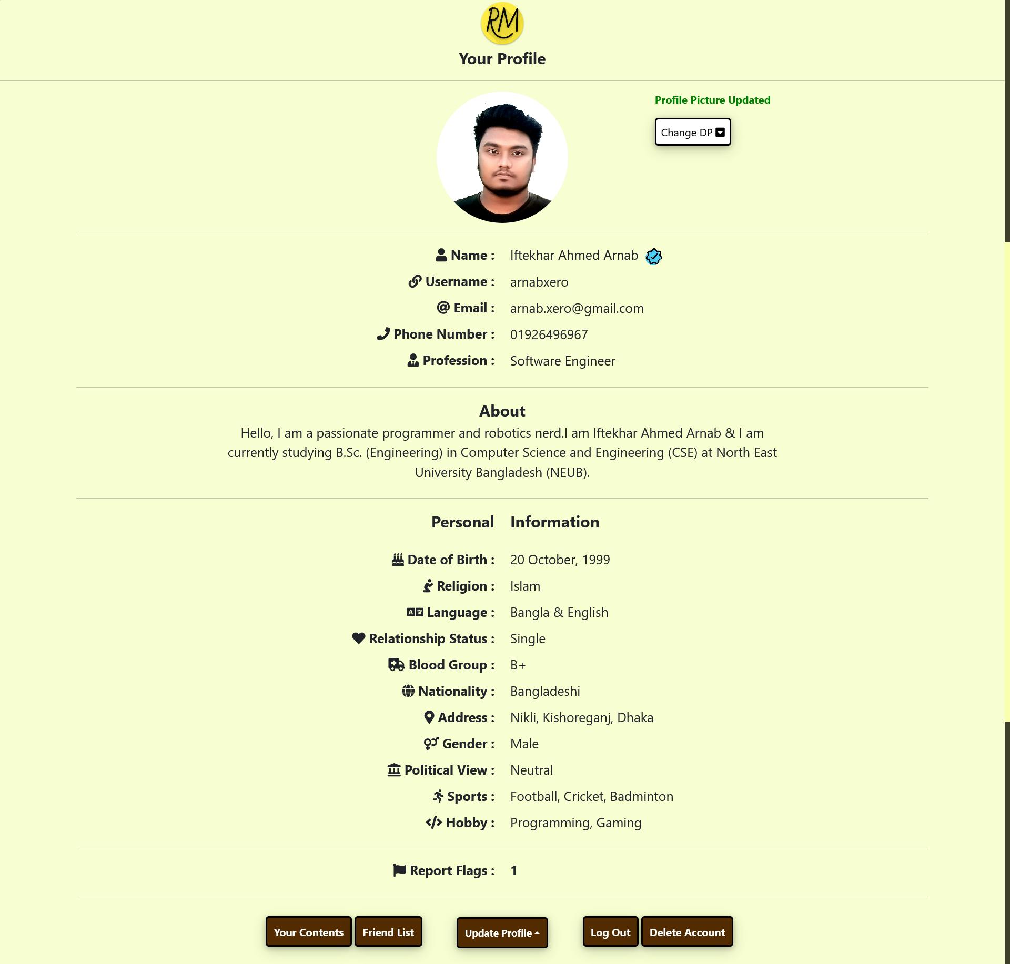
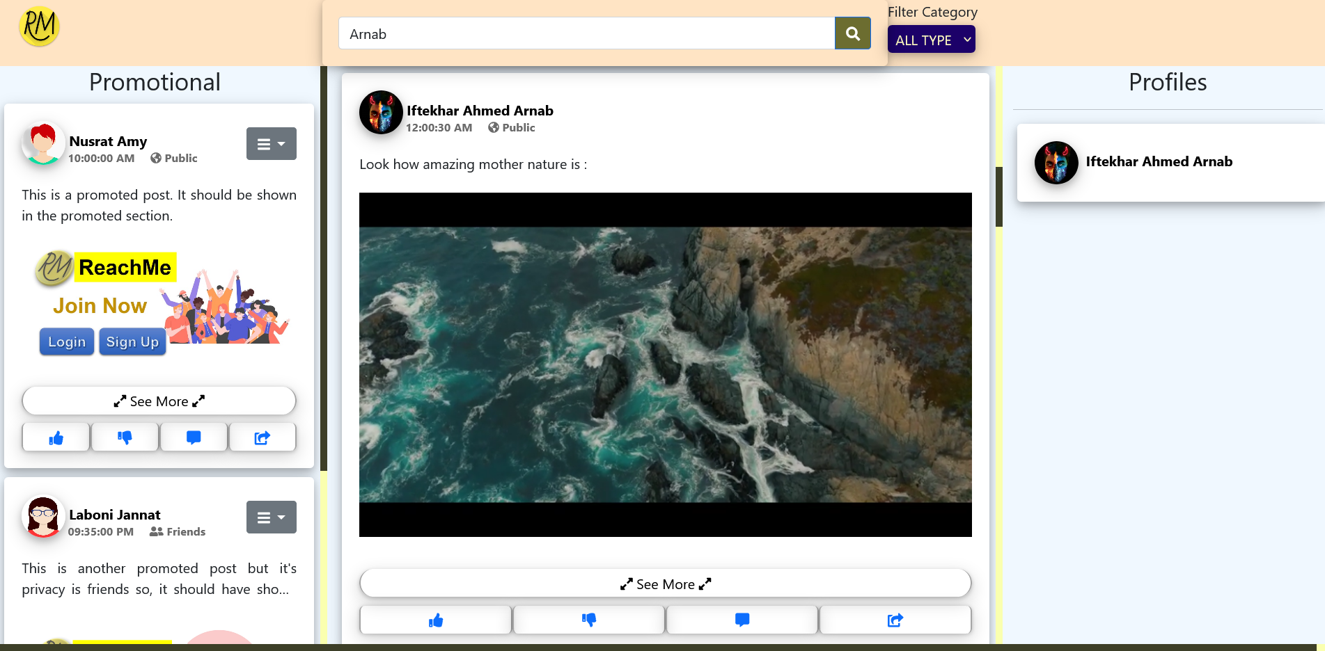
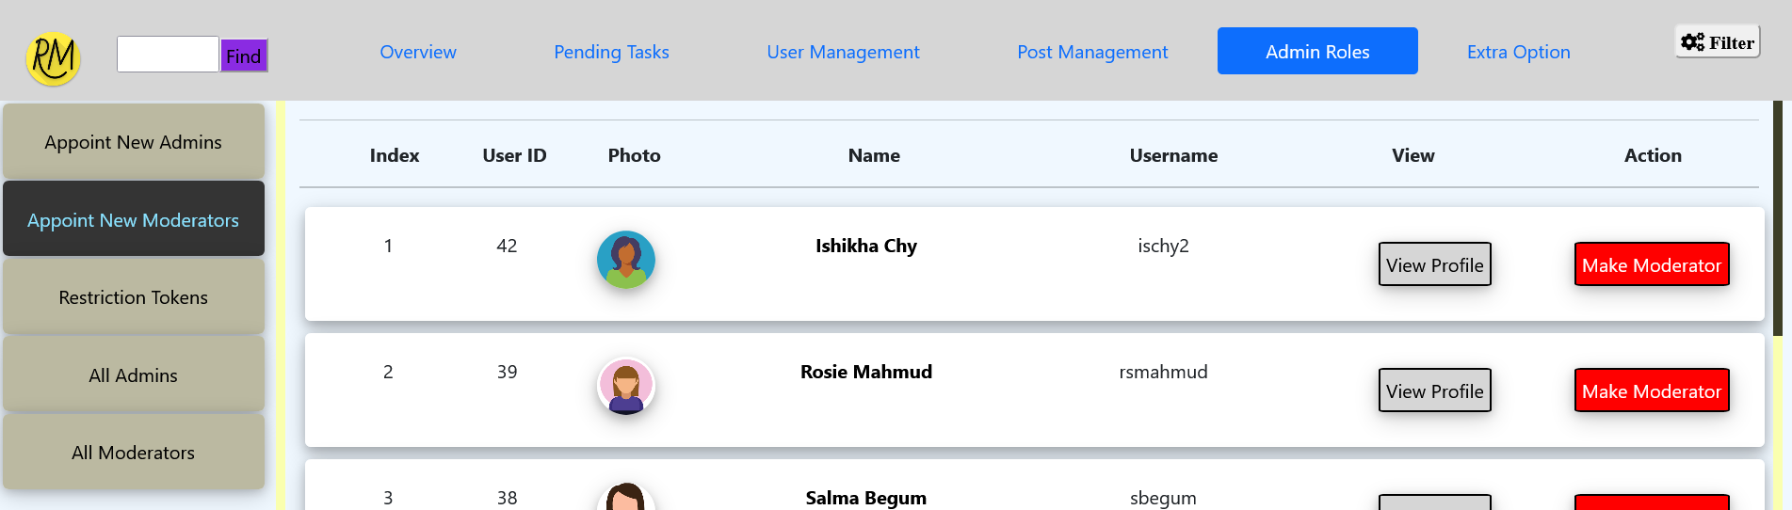
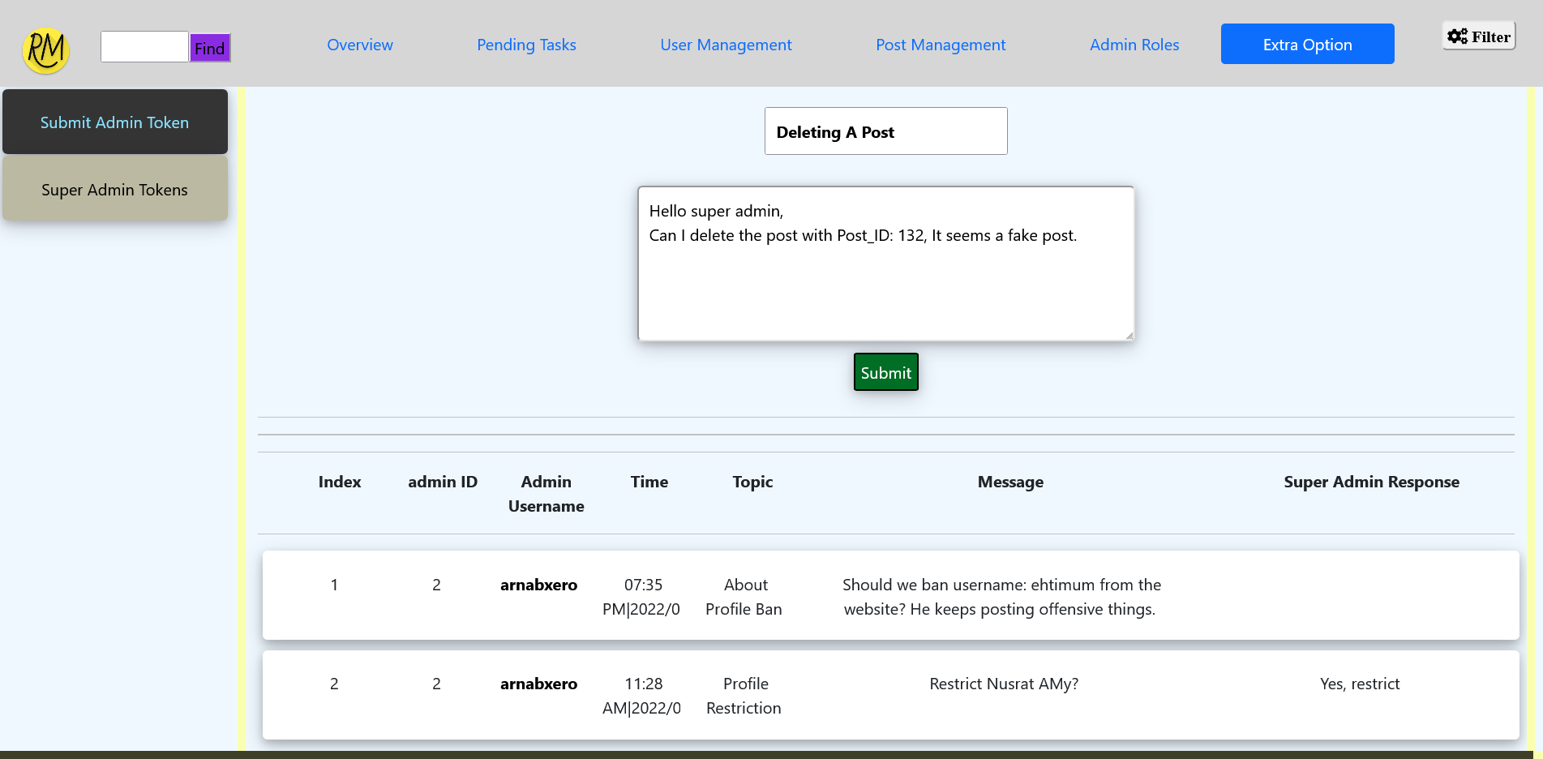
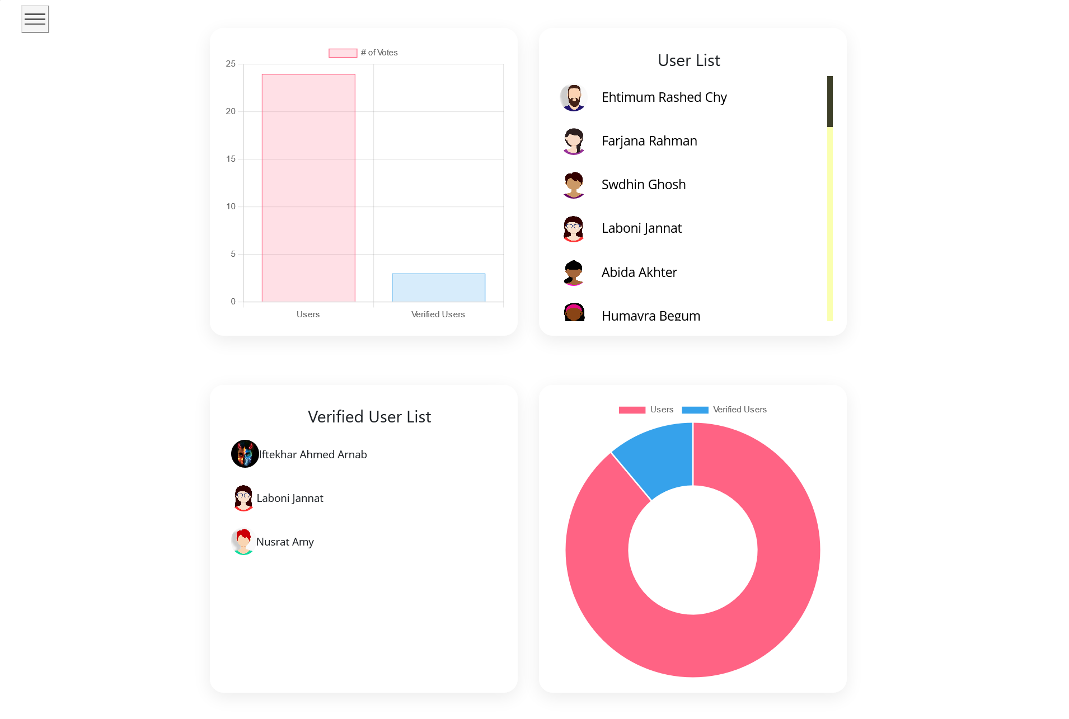
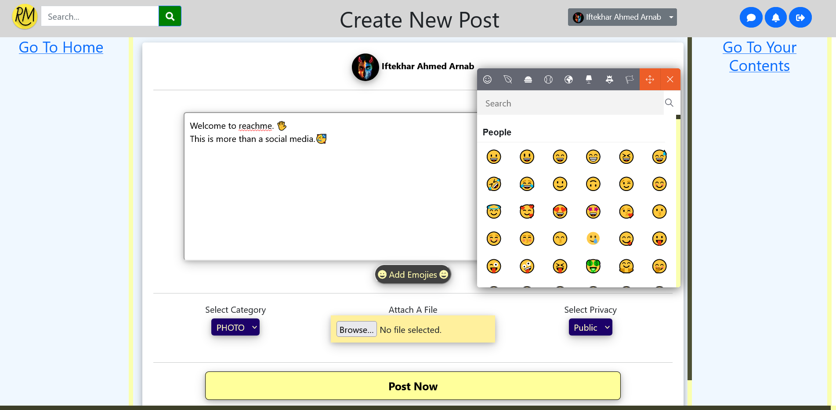
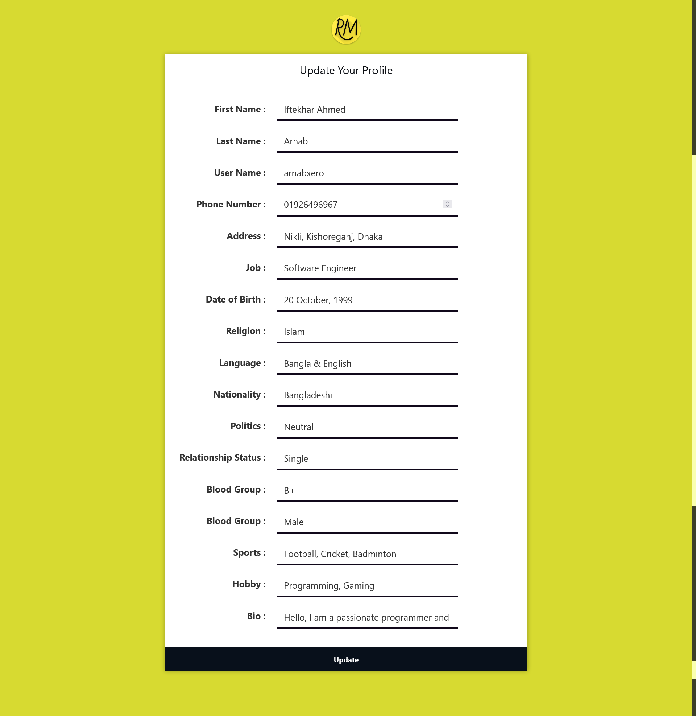
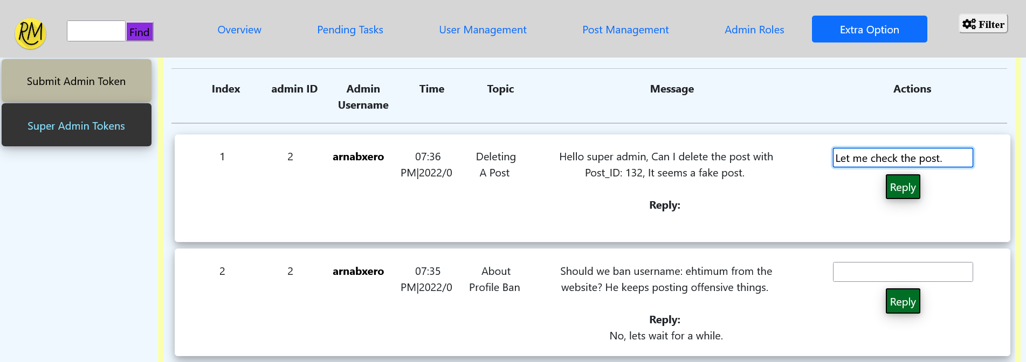
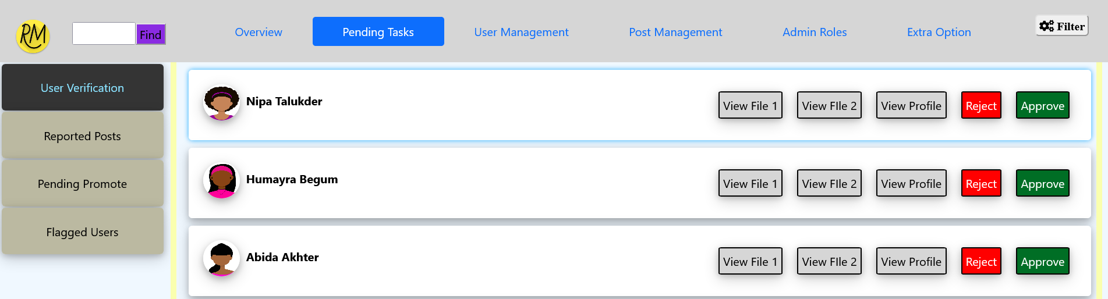
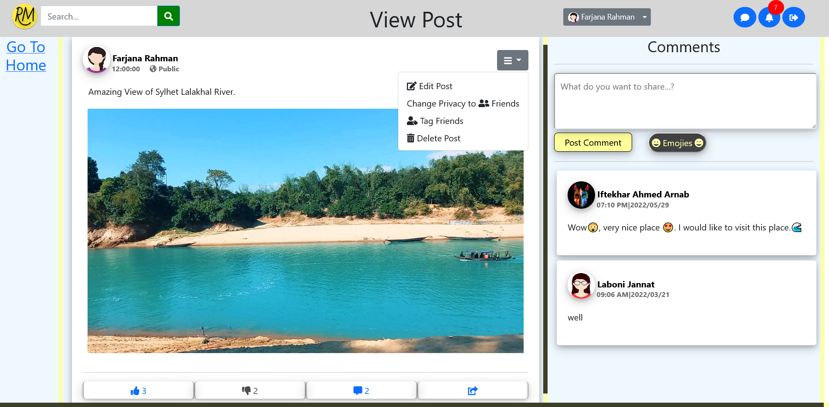
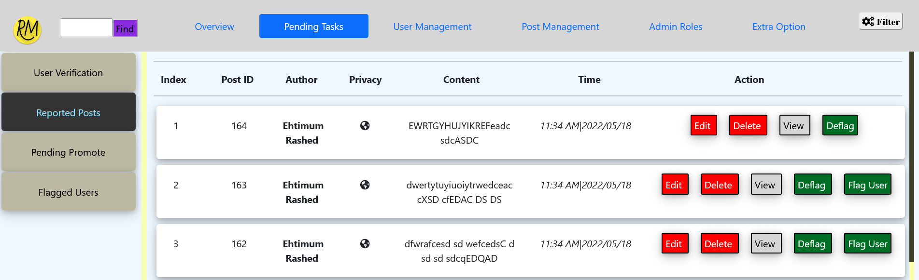
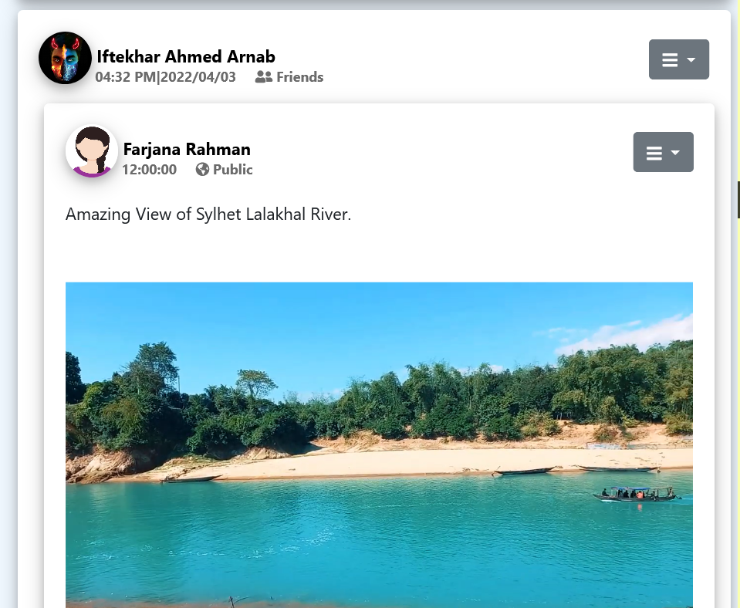
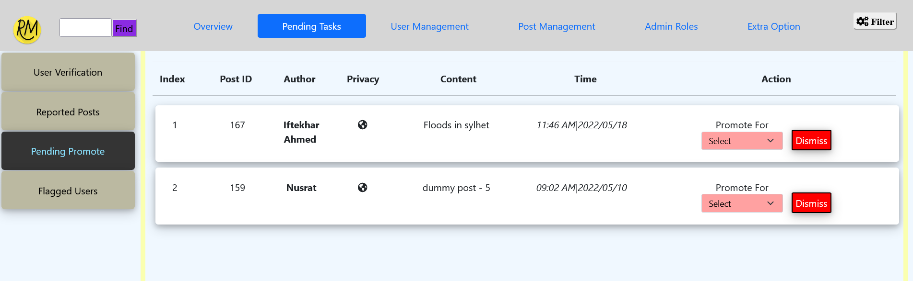
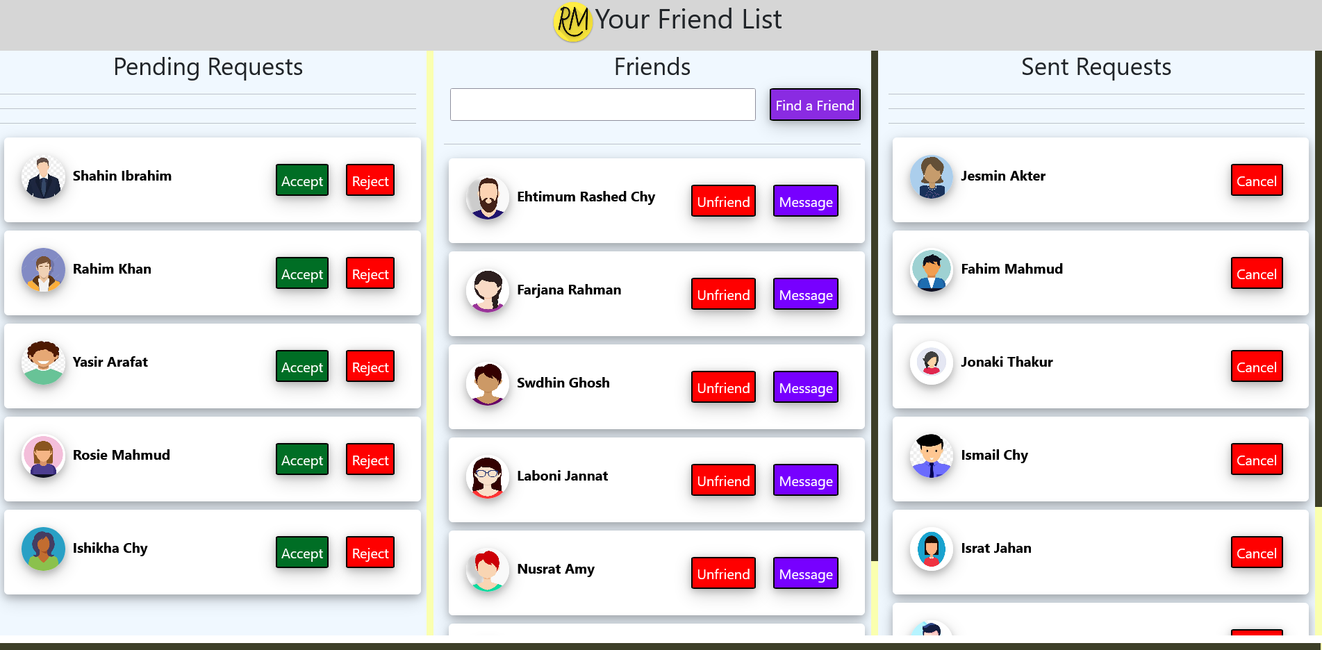
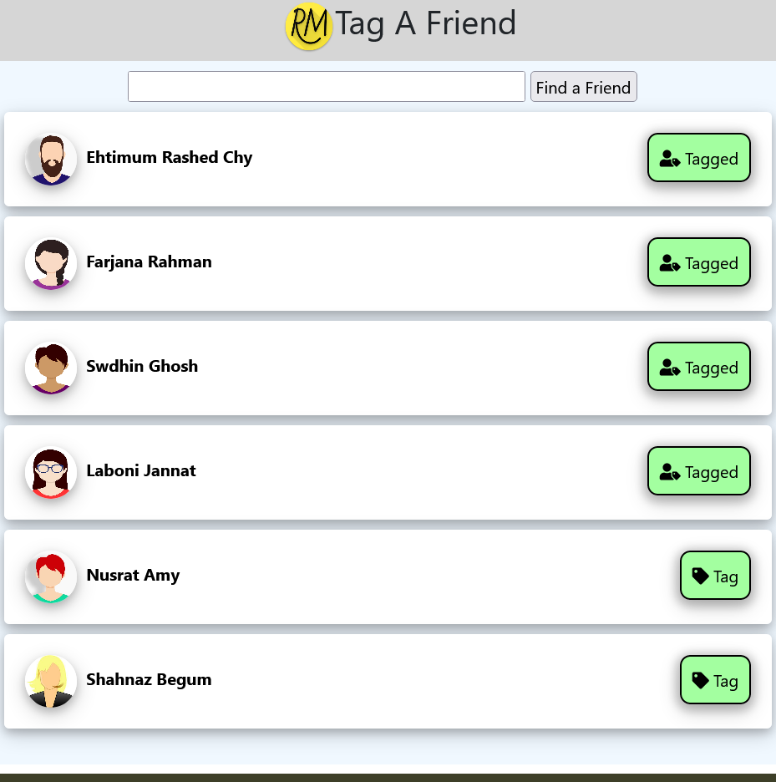
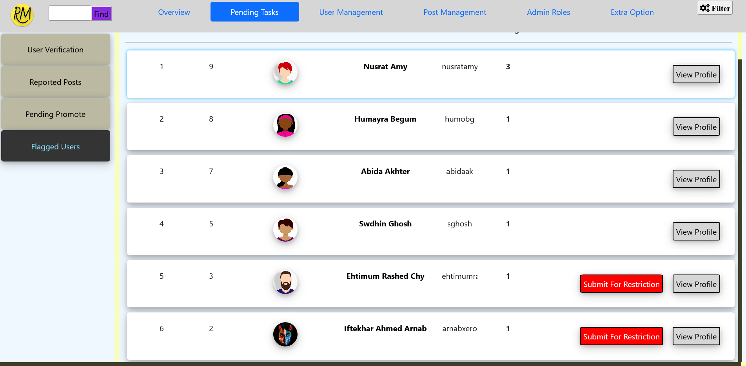
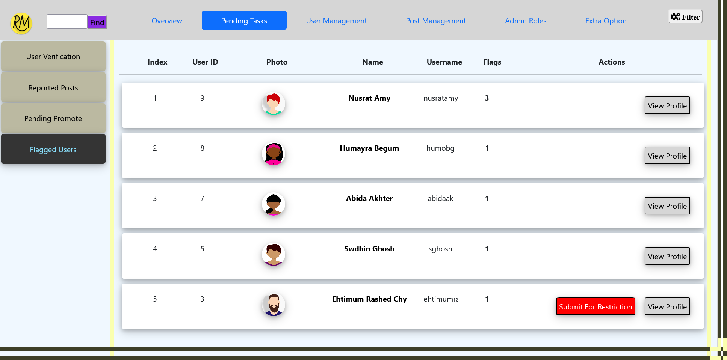
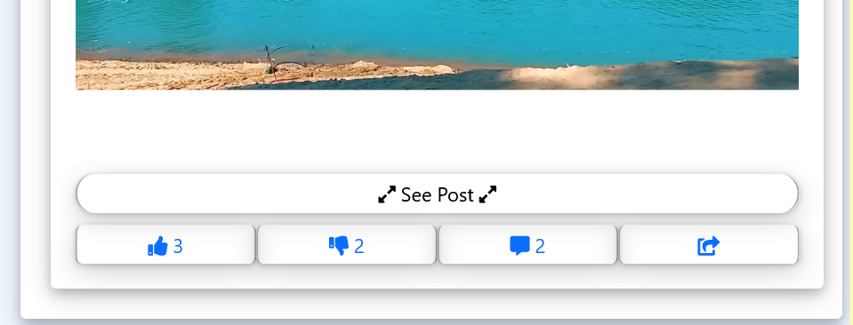
ReachMe – More Than A Social Media (For CSE – 300 at 01/06/2022)
Eftakhar Ahmed Arnob – 190103020028, Ehtimam Rashed Chowdhury – 190103020026, Farzana Rahman – 190203020101
Major Features:
Basic CRUD functionality.
A very rich & secured login, registration, account recovery & disabling system.
User profile with various details.
Secured email- password changing system.
Simple friend list & secured chat system, where user can text each other & also see other active users in the friend list.
Post create system with or without media files to share feelings or important information.
Like, dislike, comment, share, tagging & report system for posts along with secured privacy options.
A delicate notification panel to view latest notifications on various activities such as new message, friend request, likes, comments, post tagging etc.
A searching system with keywords by which user content or profiles can be found.
A homepage with header menu consisting of content category filtering, user menu, chat, notification and search bar. The homepage features promotional, personalized and alert type contents.
The site moderation tools on admin panel are user verification, reported content moderation, post promote, flagging users, user post modification via approval from a automated word scanning system etc.
The admin panel also consists of some admin tools as like appointing new admin by super admin, appointing new moderator by admins, secured internal communication system between super admin, admin and moderators etc.
Account System:
Registration, Login, Recovery & Disabling
Homepage And Notification System:
Homepage Interface
Messaging System:
Chat List & Chat System Interface
Admin Panel System
Offensive Word Scanner
Notification Panel Interface
Admin Panel Tools
Profile View & Update
Site Moderation Tools for Admins
Site Overview Interface
Post System:
Post Create Interface
Site Moderation Tools
View Post and Interaction Interface
Contribution:
Arnab initially planned the project and designed the database structure.
Arnab built the dynamic home page, post creation & friend list system.
Ehtimum built the login, registration and account recovery mechanism, chat system, profile verification system.
Farzana designed & built the search engine & post interaction system.
Farzana implemented the account ban system & admin communication system into the admin panel.
Ehtimum implemented the post report & management system to homepage and admin panel.
Arnab built the notification and post promotion system.
Tools and Technologies:
Standard HTML, CSS for front end.
JS, PHP for backend and dynamic features.
MySQL for database. MySQL event for timed MySQL commands.
JQuery for responsive chat system.
PHPMailer for verification code mailing system.
Friend List System:
Friend List Management
Shared Post and Tagging Interface

